Slide 1
ARTIFICIAL INTELLIGENCE
Phase-I project

Slide 2
Creating an AI-powered chatbot for exceptional customer service and an AI-powered diabetes prediction system is a complex endeavor. While I can't provide an actual flowchart in this text-based format, I can give you a solution abstract and describe the high-level flow for such a system.
Solution Abstract:
The proposed solution involves the development of a Python-based chatbot that serves two main purposes: providing exceptional customer service and offering an AI-powered diabetes prediction system. The chatbot is designed to enhance the user experience by addressing user queries and concerns promptly and providing personalized health insights related to diabetes risk.

Slide 3
Below is a high-level flowchart illustrating the key components and interactions within the system:
1. User Interaction:
- Users interact with the chatbot through a web or app interface.
2. Natural Language Processing (NLP):
- User queries and messages are processed by the NLP engine, which is responsible for understanding the user's intent and extracting relevant information.

Slide 4
3. Customer Service Functionality:
- If the user's query pertains to customer service, the chatbot provides assistance, answers questions, and directs users to appropriate resources or support channels.
- Responses may include FAQs, troubleshooting steps, or links to relevant help articles.
4. Diabetes Prediction Functionality:
- If the user expresses interest in diabetes prediction or health-related queries, the chatbot triggers the diabetes prediction system.
5. Data Collection:
- The chatbot collects relevant user data, which may include age, gender, family history, lifestyle factors, and medical history, necessary for diabetes risk assessment.

Slide 5
6. Machine Learning Model:
- The collected user data is processed by the diabetes prediction model, which utilizes machine learning algorithms to predict the likelihood of the user developing diabetes.
7. Prediction ResulT:
- The prediction model provides a diabetes risk assessment, which is communicated to the user in a user-friendly manner.
- The chatbot may provide personalized recommendations for preventive measures, such as lifestyle changes or medical consultations.
8. User Feedback and Interaction:
- Users can interact with the chatbot to seek clarification, ask follow-up questions, or provide feedback on the predictions and recommendations.

Slide 6
9. Continuous Improvement:
- User interactions and feedback are continuously analyzed to improve the chatbot's performance and prediction accuracy.
- The machine learning model is periodically updated with new data to enhance its predictive capabilities.
10. Data Privacy and Security:
- Throughout the process, strict data privacy and security measures are maintained to protect user information and ensure compliance with relevant regulations.

Slide 7
11. Legal and Ethical Considerations:
- Legal and ethical guidelines are adhered to, and disclaimers are provided to users regarding the limitations of the chatbot's medical predictions.
12. Maintenance and Updates:
- Regular maintenance and updates are performed to keep the chatbot and the prediction model up-to-date with the latest medical knowledge and user needs.

Slide 8
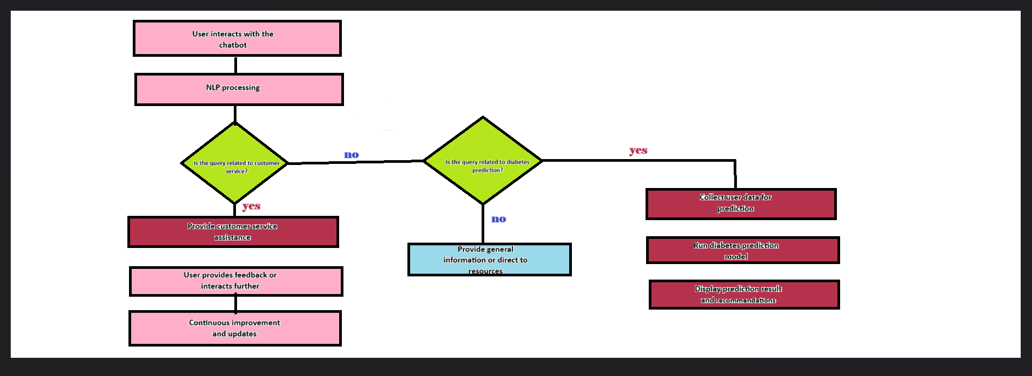
Flow chart

Slide 9
Flow chart explanation:
1.start
2.User interacts with the chatbot:
This is the initial interaction where the user engages with the chatbot by sending a message or query.
3. NLP processing:
- Natural Language Processing (NLP) techniques are used to understand and analyze the user's input. NLP helps in extracting the user's intent and relevant information from their message.

Slide 10
3. Is the query related to customer service?:
- The chatbot checks if the user's query pertains to customer service.
- If yes:
- Provide customer service assistance
- The chatbot assists the user with their customer service-related inquiry, which may include answering questions, providing support, or directing them to relevant resources.
- If no:
- Is the query related to diabetes prediction?
- The chatbot further evaluates if the user's query is related to diabetes prediction.
- If yes:
- Collect user data for prediction
- The chatbot prompts the user to provide relevant data for diabetes prediction, such as age, weight, family history, etc.
- Run diabetes prediction model
- The chatbot uses a diabetes prediction model to analyze the user's data and generate a prediction result.
- Display prediction result and recommendations
- The chatbot presents the prediction result (e.g., likelihood of developing diabetes) to the user and provides recommendations or suggestions based on the outcome.
- If no:
- Provide general information or direct to resources
- If the query is not related to either customer service or diabetes prediction, the chatbot can offer general information on various topics or guide the user to relevant external resources.

Slide 11
4. User provides feedback or interacts further:
- After receiving a response from the chatbot, the user may provide feedback, ask follow-up questions, or engage in further interaction.
5. Continuous improvement and updates:
- This step involves ongoing enhancements to the chatbot's capabilities based on user feedback and evolving user needs. It may include refining NLP models, expanding the range of services the chatbot can provide, and improving its responses over time.
6.END:
- This marks the end of the interaction between the user and the chatbot.

Slide 12
Conclusion:
The solution abstract ,flow chart and flowchart explanations are described for given problem is described.

